Slide 1
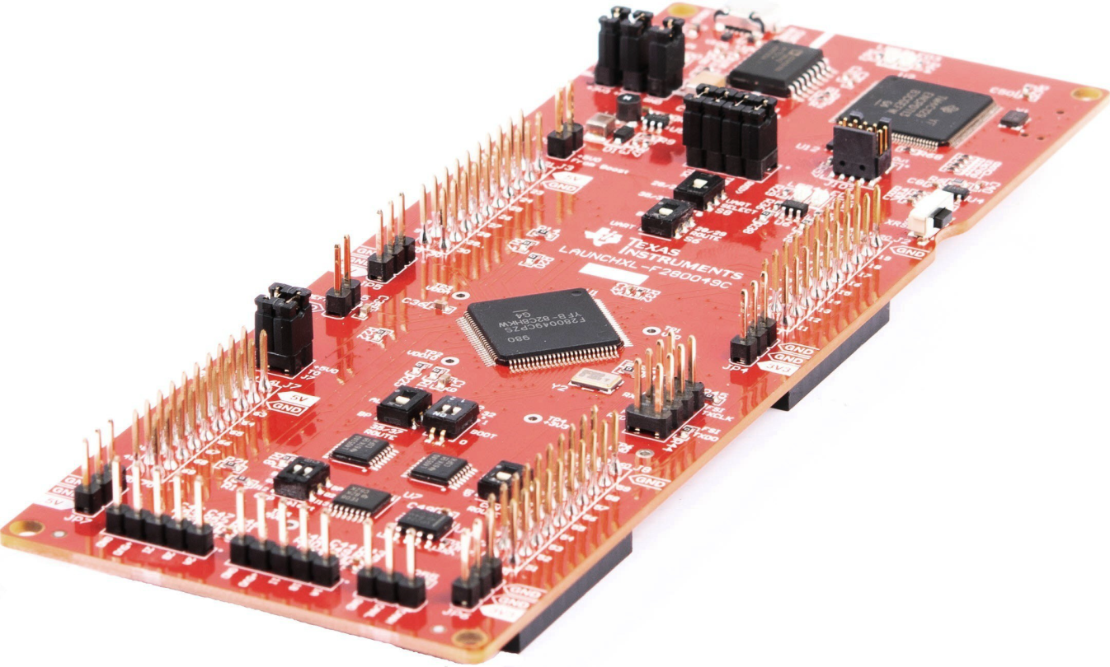

TMS320F28004x Microcontroller Workshop
Texas Instruments
C2000 Technical Training
C2000 is a trademark of Texas Instruments.
Copyright © 2019 Texas Instruments. All rights reserved.

Slide 2
Workshop Outline
1. Architecture Overview
2. Programming Development Environment
Lab: Linker command file
3. Peripheral Register Programming
4. Reset and Interrupts
5. System Initialization
Lab: Watchdog and interrupts
6. Analog Subsystem
Lab: Build a data acquisition system
7. Control Peripherals
Lab: Generate and graph a PWM waveform
8. Direct Memory Access (DMA)
Lab: Use DMA to buffer ADC results
9. Control Law Accelerator (CLA)
Lab: Use CLA to filter PWM waveform
10. System Design
Lab: Run the code from flash memory
11. Communications (SCI echoback from C2000Ware)
12. Support Resources

Slide 3
Required Workshop Materials
http://training.ti.com/c2000-f28004x-microcontroller-workshop
F280049C LaunchPad (LAUNCHXL-F280049C)
Install Code Composer Studio v9.0.1
Run the workshop installer
F28004x Microcontroller Workshop-1.0-Setup.exe
Lab Files / Solution Files
Workshop Manual

Slide 4
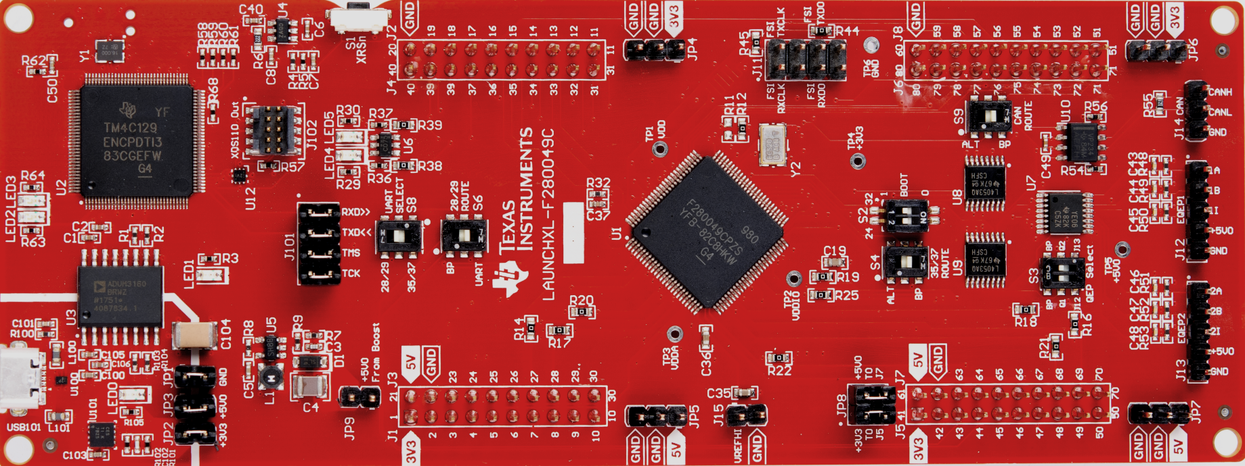
F280049C LaunchPad
XDS110 Debug Probe
LED1: Power (device)
XDS110 External Debug Port
S1: Reset
LED5: GPIO34 (green)
LED4: GPIO23 (red)
J11: FSI
S2: Boot Modes
J14: CAN
J2/J4 *
J6/J8 *
XDS110 emulation circuitry
J1/J3 *
J5/J7 *
USB101: USB Interface
LED0: Power (USB)
JP1-3: USB Power Isolation
J101: JTAG/UART Isolation
F280049
J15: VREFHI
JP8
(connects
3.3V/5V
to J5/J7)
J12/13: Encoder
* = BoosterPack plug-in module connector

Slide 5
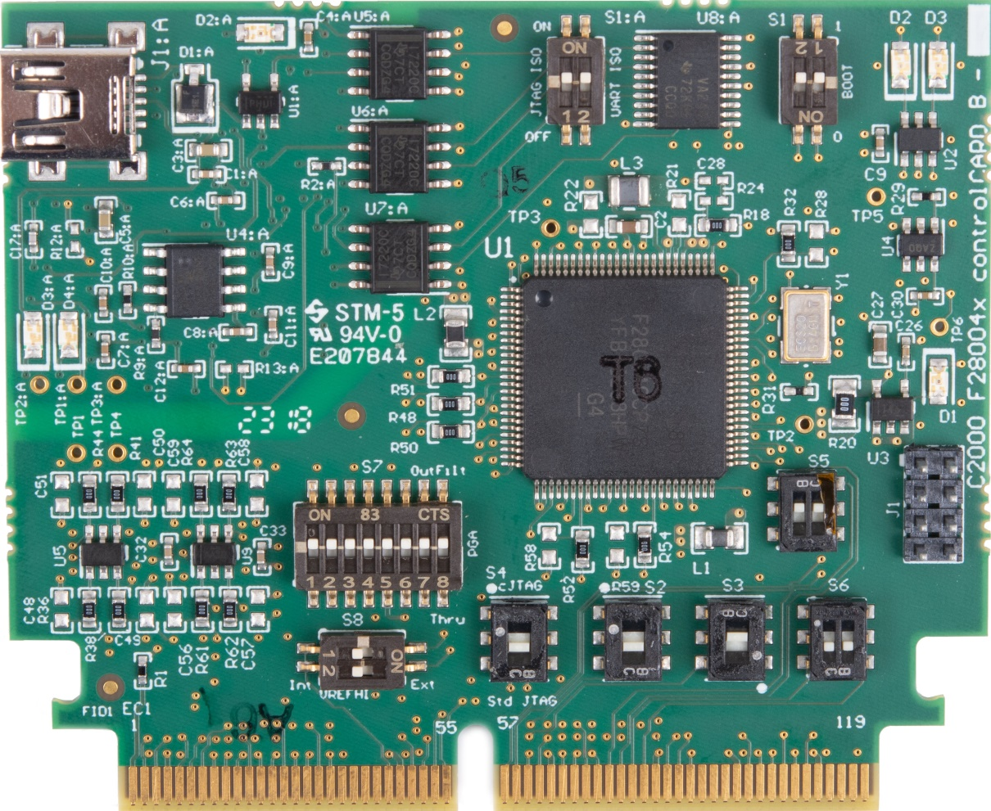
F280049C controlCARD
J1:A - USB emulation/ UART
S1:A - isolated emulation and UART communication enable switch
S1: Boot Modes
LED D2: GPIO31 (red)
LED D3: GPIO34 (red)
XDS100v2 emulation and isolation circuitry
LED D1: Power (green)
J1: FSI
S7: PGA Filter
S5: GPIO24 / GPIO25
S8: ADC VREFHI
S6: GPIO26 / GPIO27
S4: JTAG / cJTAG
S2: GPIO10 / GPIO35
S3: GPIO08 / GPIO37

Slide 6
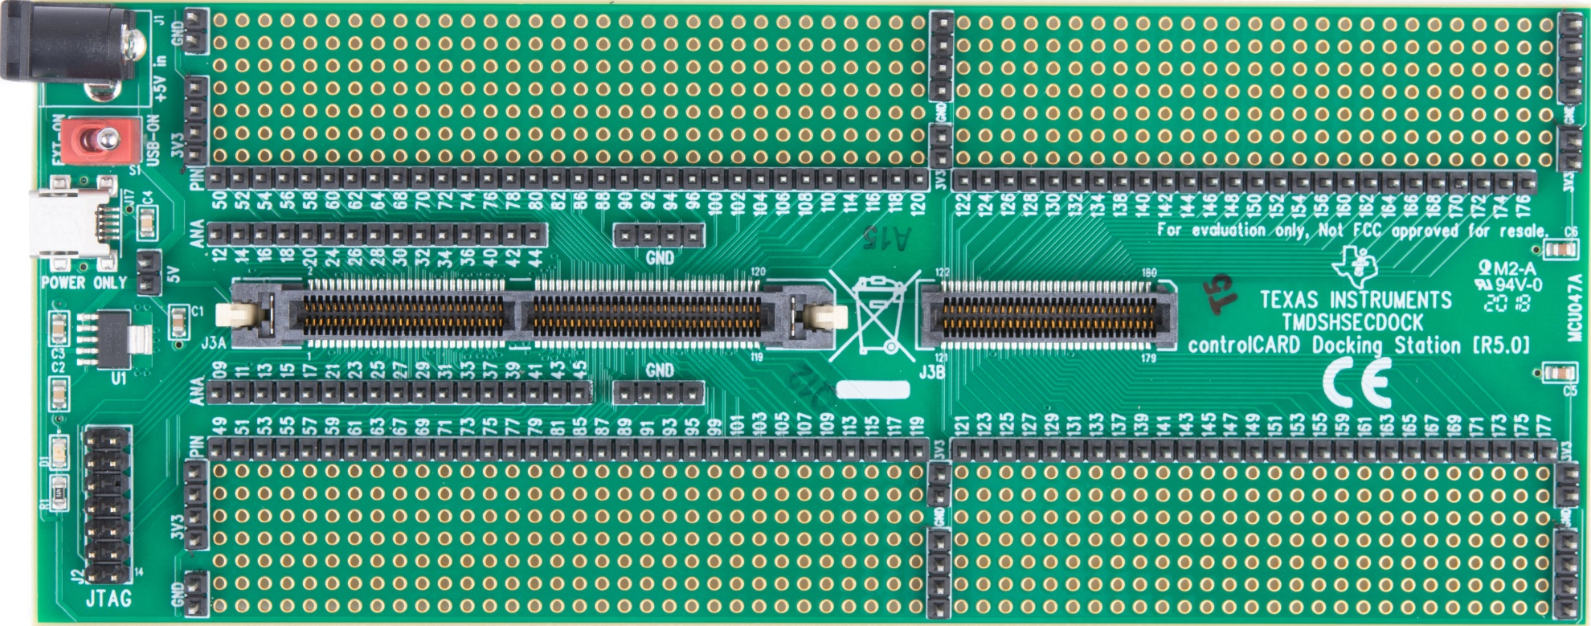
controlCARD Docking Station
5 V Power Connector
Power Switch (External / USB)
LED D1:
Power (green)
Analog
Signals
GPIO
Signals
JTAG
Connector
USB Connector
Analog
Signals
GPIO
Signals
180-pin HSEC8 Edge Card Interface

Slide 7

C2000 Technical Training
www.ti.com/c2000

